Slide 1

EDDI-1.3.1-T006-D001 Creep-Fatigue Rules for EUROFER
Jarir Aktaa

Slide 2
Summary of Deliverable Specification
Objective
Development of creep-fatigue rules for EUROFER
Activities planned in 2016
Coordinate the Creep-Fatigue test programme for Eurofer.
Collect and evaluate the generated Creep-Fatigue data.
Provided sufficient data are available,
verify the proposed Creep-Fatigue rule with the newly acquired material data
carry out direct comparison case study demonstrating the success of the proposed design rule modifications compared to the un-modified rules.
Contribute to the DDC through writing the Creep-Fatigue related chapters, keeping explanations clear and simple.
Deliverable in 2016
Report on Priority Gaps – Creep Fatigue for year 2016

Slide 3
Work to date (1)
Creep fatigue evaluation rules
Proposed modification for ferritic martensitic steels
Damage accumulation rule: ASME-BPV (Code Case N-47, T-1400) and RCC-MR (RB 3262.12)
J. Aktaa, EFDA_D_2L779C, 2014
Calculation of creep damage portion in the creep fatigue accumulation rule in
first 10% of the lifetime using S_{i} from monotonic stress strain curves and design creep curves of as received material
remaining 90% of the lifetime using S_{i} from cyclic stress strain curves and design creep curves of cyclic softened material
Using allowable total creep fatigue damage values of RCC-MR for SS 316 and Grade 91 - envelope with (0.3,0.3) tip point.

Slide 4
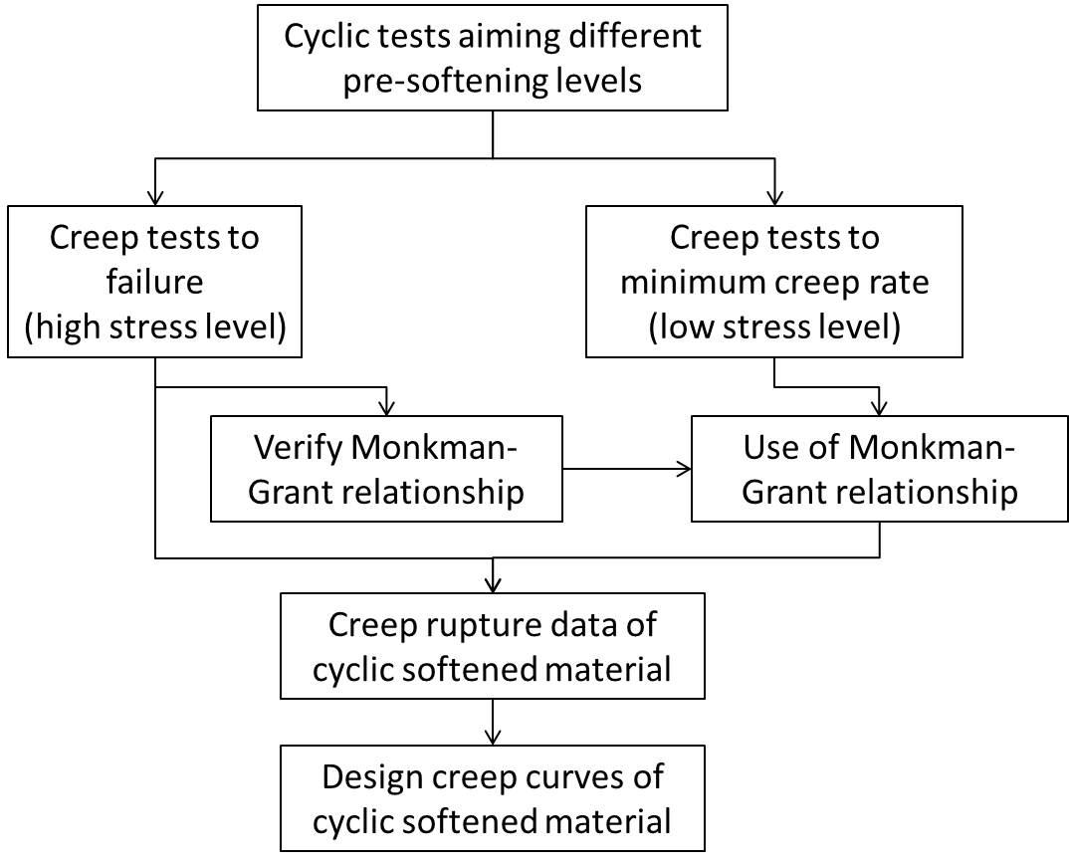
Work to date (2)
Generating design creep curves of cyclic softened EUROFER
J. Aktaa, EFDA_D_2 LDAFV, 2015

Slide 5
Work to date (3)
Generating design creep curves of cyclic softened EUROFER
 | Pre-cycling |  | Subsequent creep
Temperature in °C | Strain range in % | Number of cycles | Stress in MPa | type
550 | 0.4 | 2500 | 160 | minimum creep rate
550 | 0.4 | 2500 | 180
550 | 0.4 | 2500 | 200 | failure
550 | 0.4 | 2500 | 220
550 | 0.4 | 2500 | 240
550 | 1.0 | 250 | 160 | minimum creep rate
550 | 1.0 | 250 | 180
550 | 1.0 | 250 | 200 | failure
550 | 1.0 | 250 | 220
550 | 1.0 | 250 | 240
J. Aktaa, EFDA_D_2 LDAFV, 2015

Slide 6
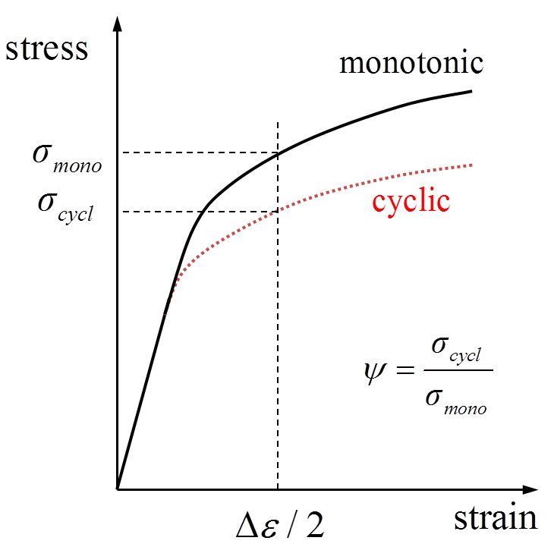
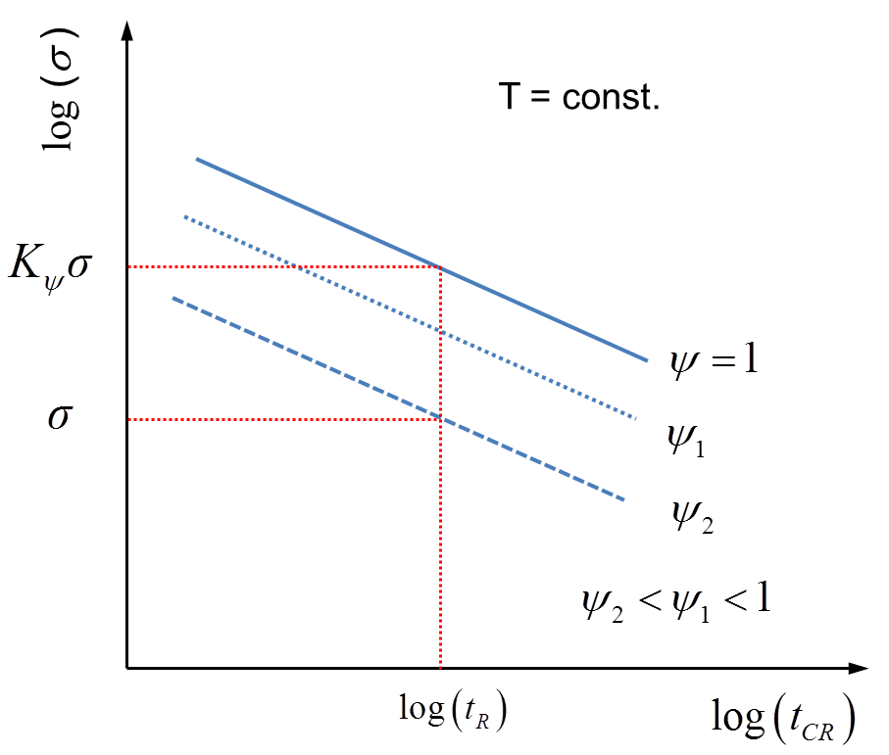
Work to date (4)
Implementation of the modification
J. Aktaa, EFDA_D_2 LDAFV, 2015

Slide 7
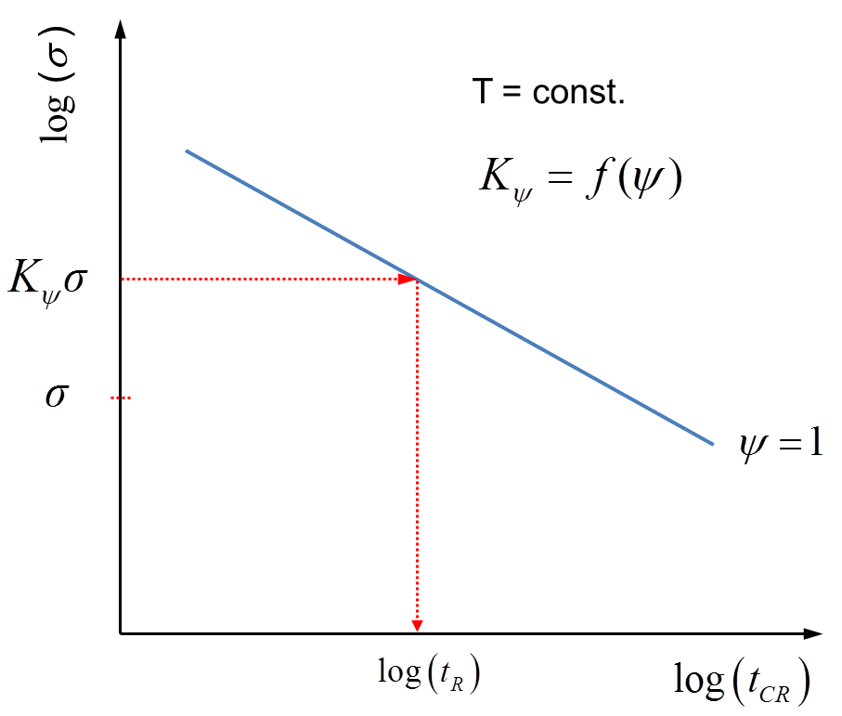
Work to date (5)
Implementation of the modification
J. Aktaa, EFDA_D_2 LDAFV, 2015

Slide 8
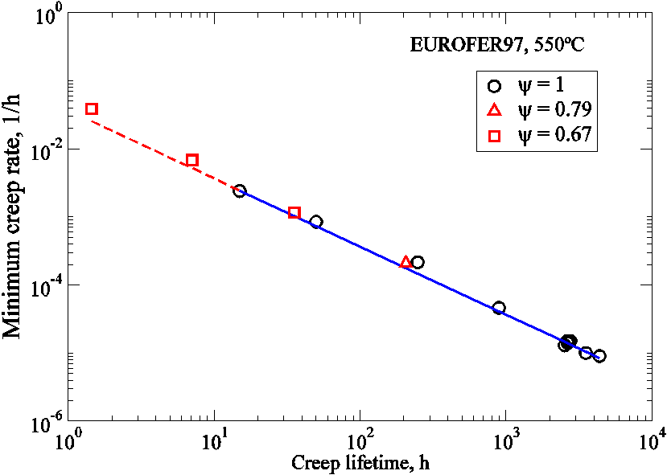
Work to date (6)
Evaluation of first creep tests on cyclic softened EUROFER (tests & data by G. Angella, CNR)
→ Independence of Monkman-Grant relationship on cyclic softening

Slide 9
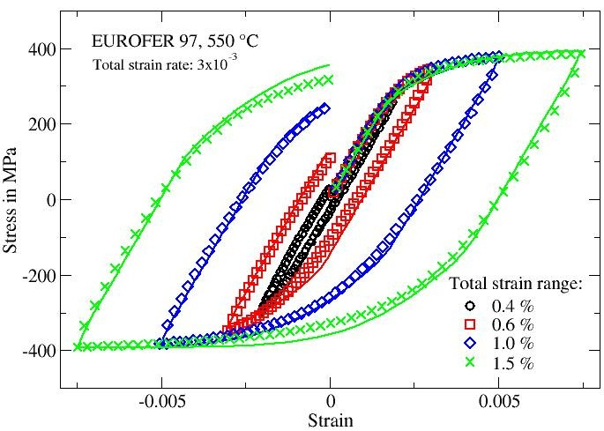
Modeling the mechanical behavior of RAFM steels
Work to date (7)
Coupled deformation damage model
New approach for the isotropic softening
Unified description of creep-fatigue damage
Fairly good description of the cyclic elasto-viscoplastic behavior and its dependence on the strain range
Aktaa & Schmitt, Fus. Eng. Des., 2006

Slide 10
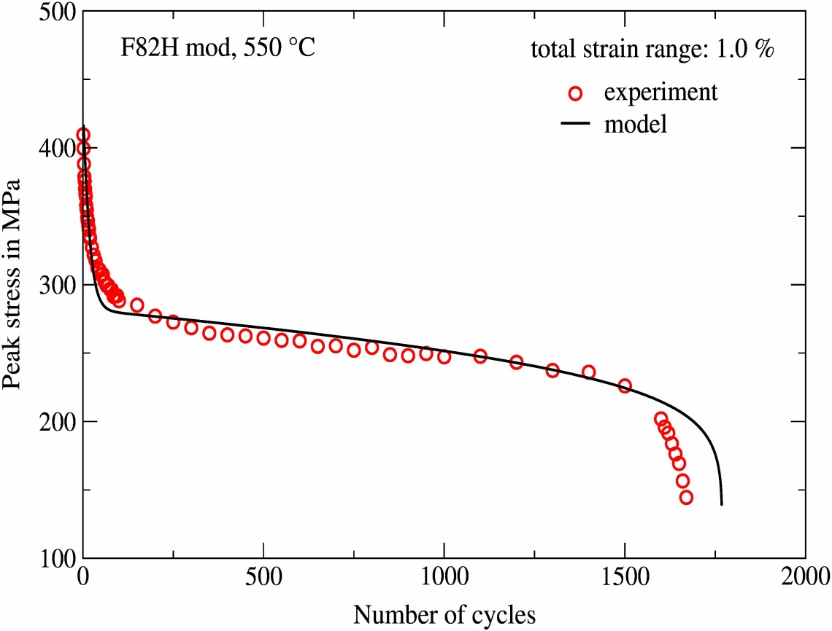
Modeling the mechanical behavior of RAFM steels
Work to date (8)
Coupled deformation damage model
New approach for the isotropic softening
Unified description of creep-fatigue damage
Fairly good description of cyclic softening as well as the damage and lifetime behavior
Aktaa & Schmitt, Fus. Eng. Des., 2006

Slide 11
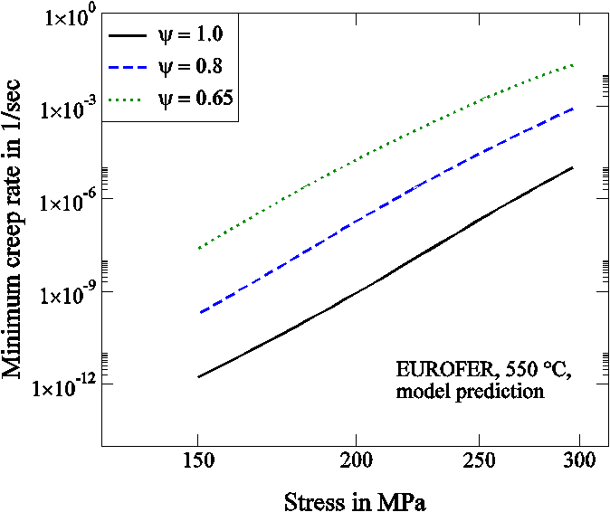
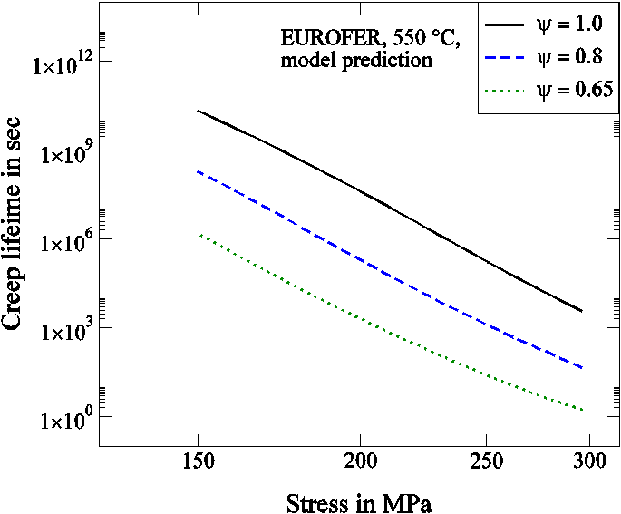
Predicting the effect of pre-cycling on creep rupture time by modeling
Work to date (9)
Aktaa & Walter, Baltica X, 2016
Monkman-Grant

Slide 12
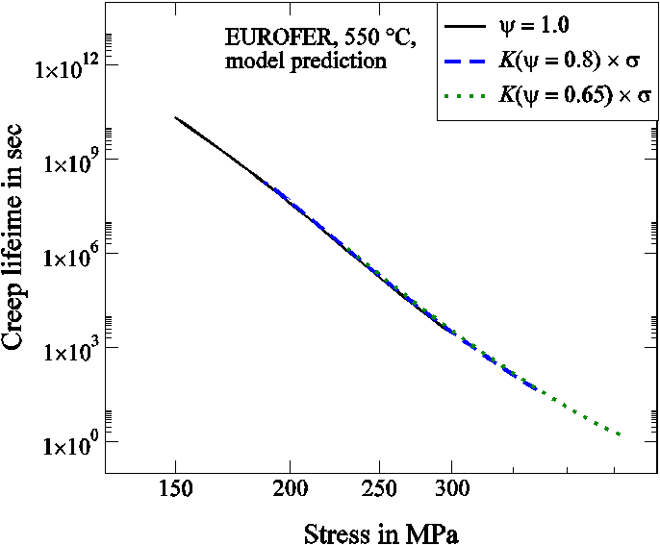
Predicting the effect of pre-cycling on creep rupture time by modeling
Work to date (10)
Aktaa & Walter, Baltica X, 2016
Evaluation of cyclic softening stress factor K_{ψ}

Slide 13
Work to date (11)
Simplified creep fatigue evaluation rules
Damage accumulation rule: ASME-BPV (Code Case N-47, T-1400) and RCC-MR (RB 3262.12)
J. Aktaa, EFDA_D_2L779C, 2014
Calculation of creep damage portion in the creep fatigue accumulation rule in
first 10% of the lifetime using S_{i} from monotonic stress strain curves, S_{r} from isochronous stress strain curves and design creep curves of as received material
remaining 90% of the lifetime using S_{i,c} = ψ S_{i} and S_{r,c} = ψ S_{r} , both amplified by the cyclic softening stress factor K_{ψ} for determining the allowable creep time from design creep curves of as received material.
Using allowable total creep fatigue damage values of RCC-MR for SS 316 and Grade 91 - envelope with (0.3,0.3) tip point.

Slide 14
Conclusions
Activities planned in 2016
Coordinate the Creep-Fatigue test programme for Eurofer.
Collect and evaluate the generated Creep-Fatigue data.
Provided sufficient data are available,
verify the proposed Creep-Fatigue rule with the newly acquired material data
carry out direct comparison case study demonstrating the success of the proposed design rule modifications compared to the un-modified rules.
Contribute to the DDC through writing the Creep-Fatigue related chapters, keeping explanations clear and simple.
Deliverable in 2016
Report on Priority Gaps – Creep Fatigue for year 2016
ü
(ü)
(ü)
(ü)
ü

Slide 15
Midterm-Review
Objective(s):
Development of creep-fatigue rules for EUROFER
Achievement and status:
Report the achievements
Creep-fatigue accumulation rules modified taking into account cyclic softening on creep damage
Tests required for application and verification of the modified rules specified
Approach simplifying the modified rules and hence easing their implementation developed
Report as well on failures (long-term as important as appearing all time “brilliant”)
-
How far are you wrt to schedule (ahead/behind)
Behind (verification tests have not been started yet)
Impact on the project
Important for the qualification of EUROFER
Interaction with other tasks/work-packages ….
MAT-1.4.1: Material testing, MAT-1.3.2: Creep-fatigue assessment tool
Long-term: WPBB

Slide 16
Conclusions
Outlook:
Complete the evaluation of creep tests on pre-softened EUROFER
Evaluation of the verification tests
Finalizing the draft for the implementation of the rules in design codes (together with Task MAT-1.3.2-T008)
Writing supporting documents for the acceptability of the modified rules and their simplifications.
Challenge
Gain acceptability of the modified rules by authorities
…

Slide 17

EUROfusion Consortium members

